Slide 1



1st Workshop on Security and Dependability of Critical Embedded Real-Time Systems
ReSecure: A Restart-Based Security Protocol
for Tightly Actuated Hard Real-Time Systems
Fardin Abdi*, Monowar Hasan* Sibin Mohan, Disha Agarwal and Marco Caccamo
*These authors have made equal contribution to this work.

Slide 2
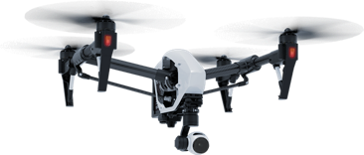
Safety-critical CPS

Slide 3
Our Idea:
Security Through
Frequent Restarts
And Fresh Reload

Slide 4
Restarting
Past to Future
Traditional Computers
Cyber-Physical Systems
Notes:
First, most of the bugs in production quality software are Heisenbugs \cite{candea2001recursive} which are hard to reproduce or depend on the timing of external events, for example race condition. Restarting is very effective in recovering from this type of bugs. Second, restarting can claim all the stale resources, clean up all the corrupt state (e.x. memory leaks, dangling pointers, damaged heap) and take system back into a known well-tested state within a predictable amount of time

Slide 5
Why Restarts?
Reliably remove malicious components
Can be performed safely for real-time system
Can be initiated through HW WD timers

Slide 6
Architecture
Sensors
RTOS
- User Input
- Network Connection
- External Peripherals
- …
Complex Controller
Decision Module
Monitoring Unit
Safety Controller
Read-Only Memory
WD Timers
PeriodicTimers
RESET
PIN
Safety Unit
Complex Unit
Rescue unit: bare-metal, verified
Main unit: OS/firmware can fail
Decision Module: Predicts if the future states are safe
CC: Not verified, can create unsafe commands
SC: Can always keep the system safe
Watchdog timer: restart the board upon fail-stop

Slide 7
Physical Safety!
Sensors
RTOS
- User Input
- Network Connection
- External Peripherals
- …
Complex Controller
Decision Module
Monitoring Unit
Safety Controller
Read-Only Memory
WD Timers
PeriodicTimers
RESET
PIN
Safety Unit
Complex Unit
Complex unit may get compromised.
Physical plant remains safe.

Slide 8
Adversary
Can Compromise Entire Complex Unit
Denial of Service Attacks
Information leakage through side-channels

Slide 9
Triggering Restarts
Monitoring Unit
Hardware Watchdog Timers

Slide 10
Monitoring Unit
Any technique can be implemented
However, still not 100% reliable

Slide 11
Hardware Timers
Independent of Software will restart
Can recover the system when the monitoring unit is compromised
Restart Timer Period
Lower Security
Higher Performance
High Security
Lower Performance

Slide 12
Optimal Periodic Restart Period

Slide 13
Properties of Attacks

Slide 14
Expected Unavailable Time

Slide 15
Expected Damage

Slide 16
Cost Function:

Slide 17
Evaluation

Slide 18
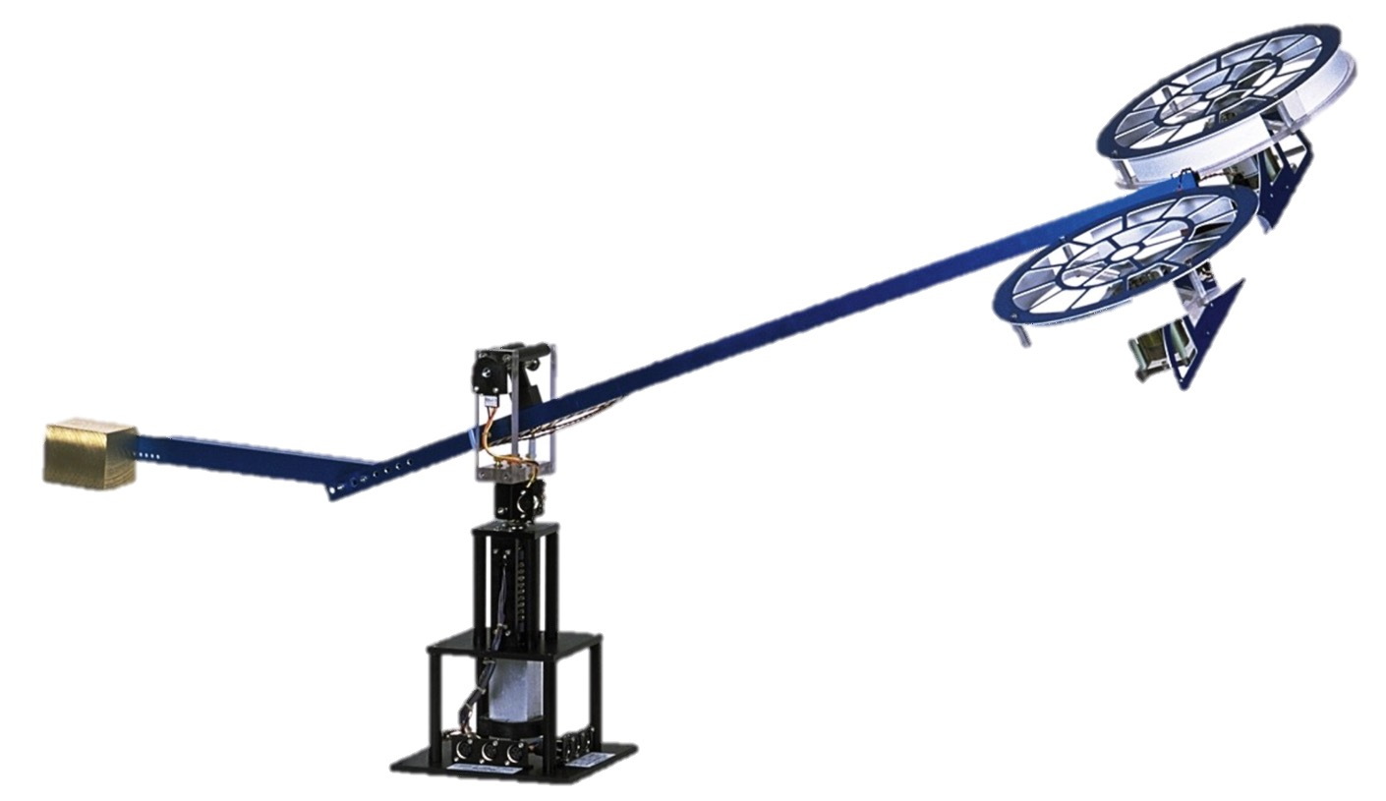
Evaluation
Complex Unit: Beagle bone black
Safety Controller: PC
Physical System: Hardware in the loop simulation of 3 degree of freedom helicopter

Slide 19
Future Directions
Domain Specific Analysis of Attack
Randomization and Restarts

Slide 20
Thanks!
Monowar Hassan
mhasan11@illinois.edu

Slide 21
Support Slides

Slide 22
Safety Controller Design
Goals:
To keep system within the Linear constraints
To satisfy the overrun constraints
To stay within the limits of actuators
Strategy:
To find a region where all the above are always satisfied
To design a state feedback controller that keeps the system within that region

Slide 23
Switching Condition for Hard Constraints
Notes:
\text{Reach}_{\leq T_{c}}(x, CC) \subseteq \mathcal{S}
\text{Reach}_{\leq T_s}(\text{Reach}_{\leq T_{c}}(x, CC), SC) \subseteq \mathcal{S}
\item$\text{Reach}_{= T_s }(\text{Reach}_{\leq T_{c}}(x, CC), SC) \subseteq \mathcal{R}

